Slide 1
SOEN 384
Management, Measurement and Quality Control http://users.encs.concordia.ca/~s384_2/
Lecture 12:
Review for the Midterm Exam (1)

Slide 2
Agenda
Review of the following midterm coverage topics:
  Topic 1: Overview of project management applied to software development projects
  Topic 2: Some Classical Measures
  Topic 7: Software Project Quality management
  Topic 3: Representational Theory of Measurement
soen384-F15-L2: review (1)

Slide 3


What is a Software-based Development Project?
A set of activities performed by people with assistance from a variety of tools, computers, compilers, software development environments, test equipment, etc.
a set of processes that connect those activities in order in which the activities must be accomplished
Constraints: scope, schedule, budget, quality
Specific characteristics:
  It is extremely difficult to look at a piece of software and to know the status of the work involved in developing it.
  Creates a unique product or service
  Different team dynamics
  …
soen384-F15-L2: review (1)

Slide 4
Topic 1: Overview of project management applied to software development projects
What is Software project management process?
What is Software measurement process?
Why two different subjects (management and measurement) are combined?
What software development project managers typically do?
What is a successful software project?
What is the main project manager goal?
Commonly Collected Project Measurement Data
Examples of commonly used measurements
Making Software Measurement a Success: the business perspective
soen384-F15-L2: review (1)

Slide 5
What is Software project management process?
2. What is Software measurement process?
[SWEBOK definitions]
Software project management process (5 subareas)
  Management process refers to the activities that are undertaken in order to ensure that the software engineering processes are performed in a manner consistent with the organization’s policies, goals, and standards.
Software engineering measurement (1 subarea)
  Measurement refers to the assignment of values and labels to aspects of software engineering (products, processes, and resources ) and the models that are derived from them, whether these models are developed using statistical or other techniques.
soen384-F15-L2: review (1)

Slide 6
3. Why two different subjects (management and measurement) are combined? (SWEBOK)
Management without measurement, qualitative and quantitative, suggests a lack of rigor
measurement without management suggests a lack of purpose or context.
soen384-F15-L2: review (1)

Slide 7
4. What software development project managers typically do?
Understand the business needs
Understand the constraints (budget, schedule, scope, volatility of requirements ... )
Negotiate a commitment (scope, schedule, budget, resources)
Lead in planning
  Identify every task, define the tasks, allocate resources to tasks, schedule tasks, and assign responsibility for completion of tasks for the overall project.
  Clearly define and manage the definition of interfaces (technical and interpersonal communication)
Communicate goals, plans, project status, and changes to all of the stakeholders.
Execute the plan by monitoring the status and indentifying discrepancies between the plan and the status, and addressing issues
soen384-F15-L2: review (1)

Slide 8
5. What is a successful software project?
On time (schedule)
Within budget (cost)
Meeting customer expectations (quality)
soen384-F15-L2: review (1)

Slide 9
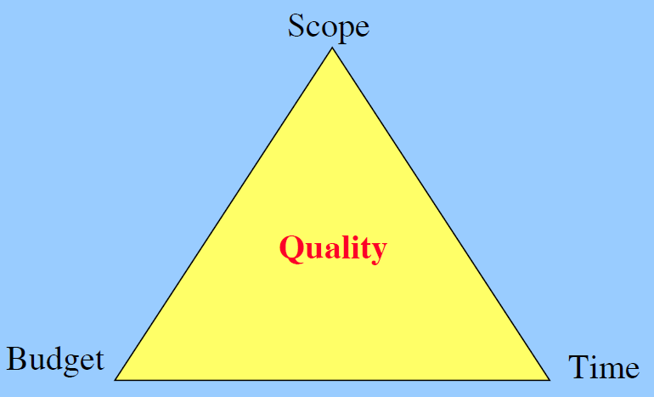
What is the main project manager goal?
Project managers’ goal:
To delivering projects on time, within budget and according to scope and quality.
soen384-F15-L2: review (1)
Notes:
Quality & The Triple constraint
source:

Slide 10
7. Commonly Collected Project Measurement Data (short list)
Product size
  SLOC. Distinguish between new and reused or automatically generated code.
  Function points (FPA, COSMIC)
Number of defects.
Quality.
  OO code quality, Defect density, reliability, performance, security, safety, maintainability, …
Effort.
  Person-Month. Basic monitoring parameter to assure that you stay within budget
Schedule and time.
  budget adherence, earned value, etc. Iteration completion must be lined up with defined quality criteria to avoid poor quality being detected too late
Number of developers
Project progress.
  evaluate how results (such as implemented and tested requirements or closed work packages) relate to the effort spent and elapsed time.
soen384-F15-L2: review (1)
Notes:
Measurements—such as schedule and
budget adherence, earned value, or quality
level—are typical performance indicators
that serve as traffic lights on the status
of the individual project. Only projects in
amber and red status that run out of agreed
variance (which, of course, depends on
the maturity of the organization) would
be investigated.

Slide 11
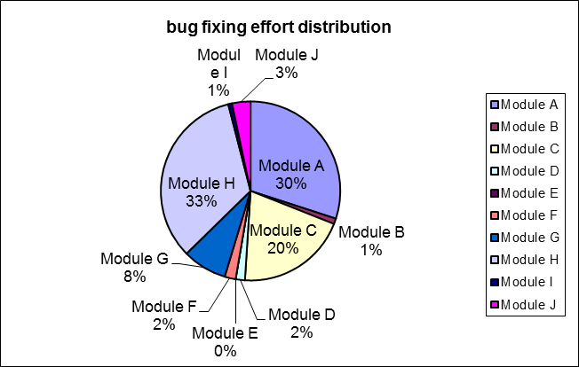
8. Examples of commonly used measurements
Productivity= length / effort
Defect Density = #defects / length
Estimated Effort =
Percentage of the total effort to fix bugs required to resolve the defects fixed in each module per Sprint
a * CFP ^{b}
 | Modules | bug fixed | effort (p-h)
 | Module A | 11 | 45
 | Module B | 3 | 1.5
 | Module C | 13 | 30
 | Module D | 1 | 2.5
 | Module E | 0 | 0
 | Module F | 2 | 3
 | Module G | 1 | 12
 | Module H | 14 | 50
 | Module I | 2 | 1
 | Module J | 3 | 5
 |  | 50 | 150
soen384-F15-L2: review (1)
Notes:
Software A has 100 defects
Software B has 1 defect.
Can we compare A and B?
More: A has 10,000 lines of code and B has 10 lines of code
=> Defect Density (A) < Defect Density (B)

Slide 12
9. Making Software Measurement a Success: the business perspective
Introduction cost of a measurement program: 1-2% of the total R&D or IT effort
Up to 10-20% of immediate savings
  Why?...
soen384-F15-L2: review (1)

Slide 13
Absolutely necessary project measurements (short list)
Product size
  SLOC. Distinguish between new and reused or automatically generated code.
  Function points (FPA, COSMIC)
Number of defects.
Quality.
  Defect density, reliability, performance, security, safety, maintainability, …
Effort.
  Person-Month. Basic monitoring parameter to assure that you stay within budget
Schedule and time.
  budget adherence, earned value, etc. Iteration completion must be lined up with defined quality criteria to avoid poor quality being detected too late
Project progress.
  evaluate how results (such as implemented and tested requirements or closed work packages) relate to the effort spent and elapsed time.
soen384-F15-L2: review (1)
Notes:
Measurements—such as schedule and
budget adherence, earned value, or quality
level—are typical performance indicators
that serve as traffic lights on the status
of the individual project. Only projects in
amber and red status that run out of agreed
variance (which, of course, depends on
the maturity of the organization) would
be investigated.

Slide 14
Topic 2: Some Classical Measures
Length
OO CK quality Measures
McCabe Cyclomatic Complexity
soen384-F15-L2: review (1)

Slide 15
Classical example of measurement: Code Length
Physical LOC corresponds to one line starting with the first character and ending by a carriage return or an end-of-file marker of the same line, and which excludes the blank and comment line.
Logical LOC is given by the number of “statements” in a program
  Language dependent!
  => the counting of logical LOC is ambiguous
soen384-F15-L2: review (1)

Slide 16
Size Classical Measures:
SLOC
SLOC represents source lines of code
The SLOC is the oldest, most commonly-used, and one of the most widelycited size metric in the industry.
soen384-F15-L2: review (1)

Slide 17
SLOC measurement:
Key points
Logical lines
  invariant to editing changes
  correlate with development effort
  uniquely definable
  complex to count
Physical lines
  are easy to count
  are not invariant
  must be precisely defined for each case
soen384-F15-L2: review (1)

Slide 18
Size Accounting
(Carnegie Mellon Software Engineering Institute, PSP lectures)
For small products, size tracking can be done manually, but it requires care.
For larger products, size tracking requires an accounting system.
Size accounting provides an orderly and precise way of tracking size changes through multiple product versions.
soen384-F15-L2: review (1)

Slide 19
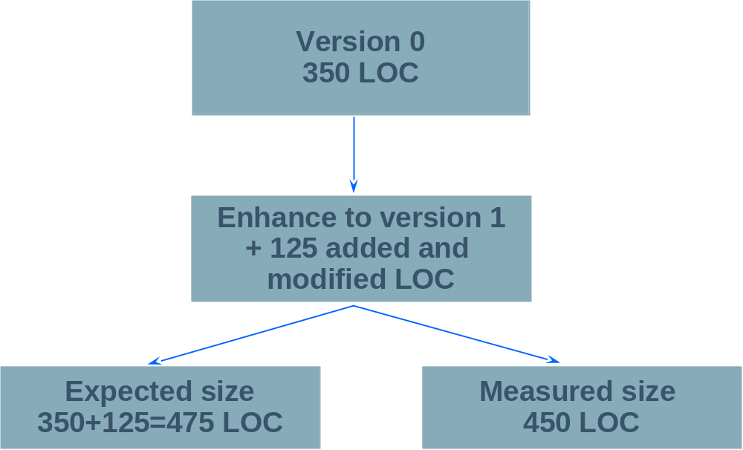
Example of Size Accounting -- 1 (Carnegie Mellon Software Engineering Institute, PSP lectures)
What happened?
soen384-F15-L2: review (1)

Slide 20
Example of Size Accounting -2
(Carnegie Mellon Software Engineering Institute, PSP lectures)
 | Added | Subtracted | Base
Base V0 |  |  | 0
Deleted |  | 0
Modified | 0 | 0
Added | 350
Base V1 | 350 | -0 | 350
Deleted |  | 0
Modified | 25 | 25
Added | 100
V1 Product | 125 | -25 | 450
Total Added and Modified LOC |  |  | 475

Slide 21
Analysis and Feedback
Size data help to make better plans
    Size and time are often correlated, and when they are, size estimates can be used to estimate effort. Plans can then be created based on the size and effort estimates.
Size data are useful for tracking development effort
    Size measures relate the effort expended to the amount of product produced, inspected, tested, etc.
… (next slide)
soen384-F15-L2: review (1)

Slide 22
Analysis and Feedback (2)
Size data help in assessing program quality
    Normalizing defect data based on size permits determination of the quality of all or some part of the development process
    relative defect content of some parts of large programs
soen384-F15-L2: review (1)

Slide 23
Messages to Remember
(Carnegie Mellon Software Engineering Institute, PSP lectures)
To effectively plan and manage your work, you must measure product size.
For each measure, size must correlate with development time.
If the size measure does not correlate or is not automatically countable, it will not be very useful.
Every size measure should be precisely defined and automatically countable.
soen384-F15-L2: review (1)

Slide 24
Absolutely necessary project measurements (short list)
Product size
  SLOC. Distinguish between new and reused or automatically generated code.
  Function points (FPA, COSMIC)
Number of defects.
Quality.
  Defect density, reliability, performance, security, safety, maintainability, …
Effort.
  Person-Month. Basic monitoring parameter to assure that you stay within budget
Schedule and time.
  budget adherence, earned value, etc. Iteration completion must be lined up with defined quality criteria to avoid poor quality being detected too late
Project progress.
  evaluate how results (such as implemented and tested requirements or closed work packages) relate to the effort spent and elapsed time.
soen384-F15-L2: review (1)
Notes:
Measurements—such as schedule and
budget adherence, earned value, or quality
level—are typical performance indicators
that serve as traffic lights on the status
of the individual project. Only projects in
amber and red status that run out of agreed
variance (which, of course, depends on
the maturity of the organization) would
be investigated.

Slide 25

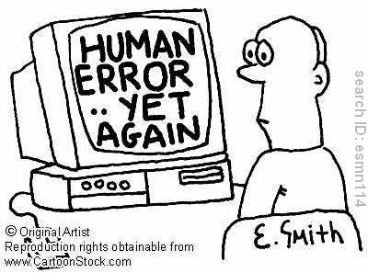
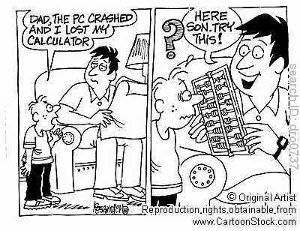

error, defect (fault), failure (incident)
Error
It is there in the program…
Fault
TESTER
Failure
Observed Incident
soen384-F15-L2: review (1)

Slide 26
Basic definitions
  An error is a slip-up or inappropriate decision by a software developer that leads to the introduction of a defect
  A defect (fault) is a flaw in any aspect of the system that contributes, or may potentially contribute, to the occurrence of one or more failures
  A failure (incident) is an unacceptable behaviour exhibited by a system
soen384-F15-L2: review (1)

Slide 27
Defects severity classification
(Fenton’s book, Chapter 5)
catastrophic failures involve the loss of one or more lives, or injuries causing serious and permanent incapacity
critical failures cause serious permanent injury to a single person but would not normally result in loss of life to a person of good health. This category also includes failures causing environmental damage.
significant failures cause light injuries with no permanent or long term effects.
minor failures result neither in personal injury nor in a reduction to the level of safety provided by the system.
soen384-F15-L2: review (1)

Slide 28
Typical Failure report
(Fenton’s book, Chapter 5)
Location: such as installation where failure was observed
Timing: CPU time, clock time or some temporal measure
Symptom: type of error message or indication of failure
End result: description of failure, such as “operating system crash,” “services degraded,” “loss of data,” “wrong output,” “no output”
Mechanism: chain of events, including keyboard commands and state data, leading to failure
Cause: reference to possible fault(s) leading to failure
Severity: reference to a well-defined scale, such as “critical,” “major,” “minor”
Cost: Cost to fix plus cost of lost potential business
soen384-F15-L2: review (1)

Slide 29
Defects Analysis and Feedback
QUALITY STANDARDS DEFECT MEASUREMENT MANUAL, United Kingdom Software Metrics Association (UKSMA)
Defect Density (DD)
Defect Detection Efficiency (DDE)
Defect Removal Efficiency (DRE)
Outstanding Defects
soen384-F15-L2: review (1)

Slide 30
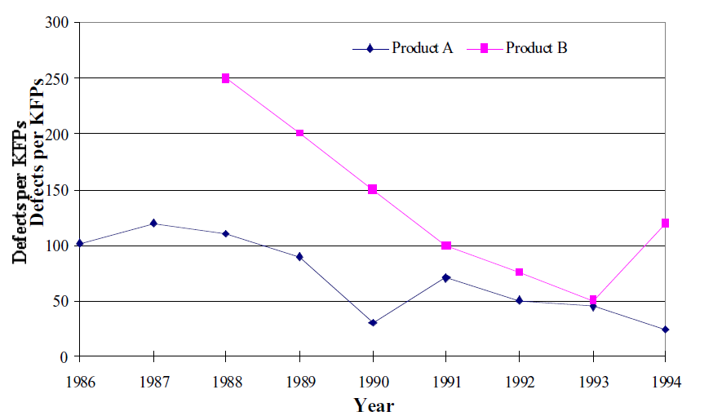
Defect density
QUALITY STANDARDS DEFECT MEASUREMENT MANUAL, United Kingdom Software Metrics Association (UKSMA)
Defect density = Number of Defects / SLOC
soen384-F15-L2: review (1)
Notes:
Defect Density of software (RDD) is the number of confirmed defects
detected during a defined period of operation divided by the size of the software. The period
might be for the first month, three months, year or live-to-date .
The size is typically and preferably measured in Function Points (FP), but may also be
measured in Source Lines of Code counted according to an agreed convention.
Defect densities can also be determined for the whole or each phase of the development life
cycle.Figure 3 shows the defect density trends for two products. Note, the increases in defect
density for products A and B illustrate the effect of new releases. There are many possible
reasons for the higher defect density of Product B compared with that of Product A. Product
B may have been developed by an inexperienced team, developed using new unfamiliar
technology, the requirements may have been unstable or inadequate testing had been
carried out.

Slide 31
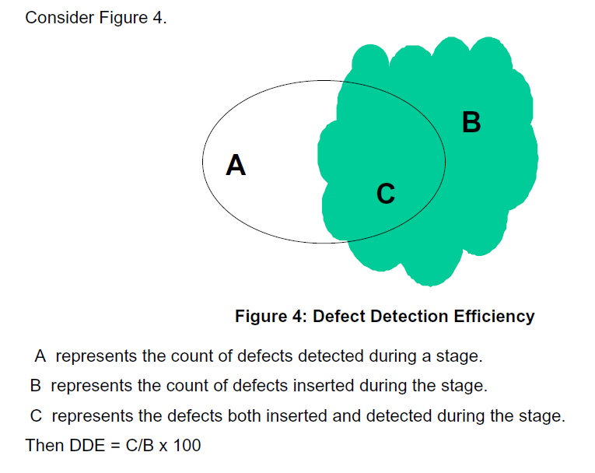
Defect Detection Efficiency (DDE)
QUALITY STANDARDS DEFECT MEASUREMENT MANUAL, United Kingdom Software Metrics Association (UKSMA)
Measurement Formula:
[(number of defects inserted and detected) / total number of defects inserted ] *100
soen384-F15-L2: review (1)

Slide 32
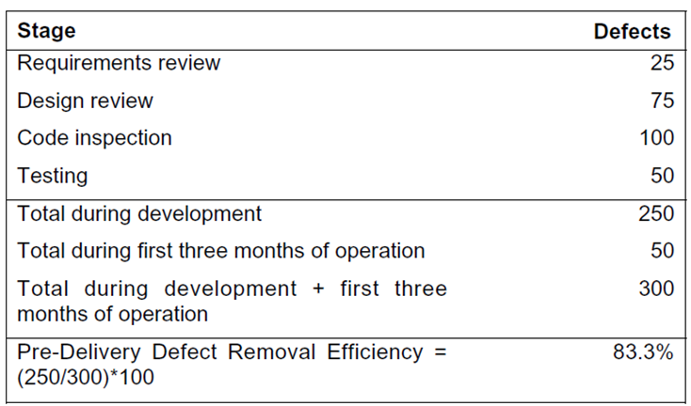
Defect Removal Efficiency (DRE)
QUALITY STANDARDS DEFECT MEASUREMENT MANUAL, United Kingdom Software Metrics Association (UKSMA)
A measure of the defects removed prior to delivery of the software to the customer, expressed as a percentage of the sum of all defects detected to date.
A Defect Removal Efficiency (DRE) can be determined for each stage of the development life cycle
soen384-F15-L2: review (1)
Notes:
A Defect Removal Efficiency (DRE) can be determined for each stage of the development
life cycle, if desired.

Slide 33
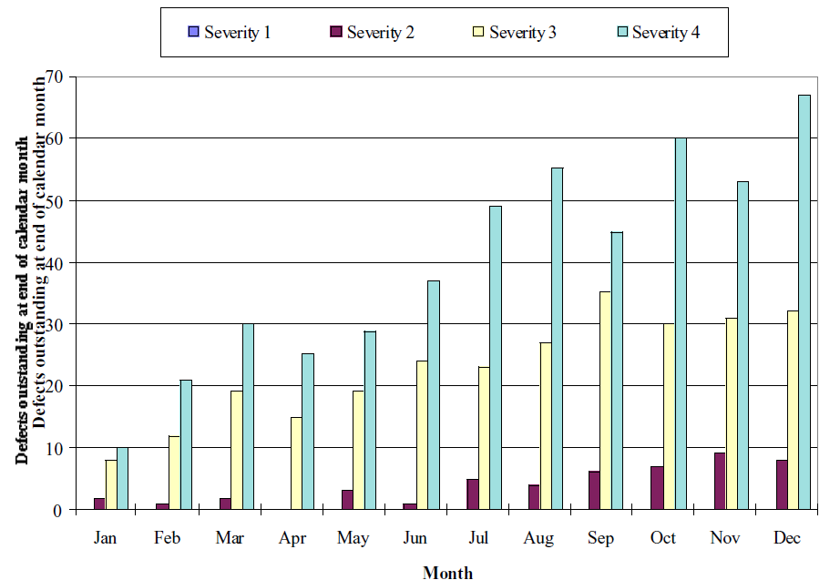
Outstanding Defects
QUALITY STANDARDS DEFECT MEASUREMENT MANUAL, United Kingdom Software Metrics Association (UKSMA)
Confirmed defects by defect severity at the end of each calendar month for a portfolio of applications.
This is a measure of the efficiency of the QA processes
soen384-F15-L2: review (1)
Notes:
In the example, a clear trend indicates that the organisation is coping with Severity One
defects, but that other defect categories are building up and the organisation is unable to
cope.

Slide 34
Lessons learned
Size is an important attribute of product used for project planning and estimation (of effort, time and resources)
Number, type and severity of defects can be used to evaluate different quality attributes (outstanding defects tracking, defect density, defect detection/removal efficiency, etc.)
soen384-F15-L2: review (1)

Slide 35
Absolutely necessary project measurements (short list)
Product size
  SLOC. Distinguish between new and reused or automatically generated code.
  Function points (FPA, COSMIC)
Number of defects.
Quality.
  OO code quality, Defect density, reliability, performance, security, safety, maintainability, …
Effort.
  Person-Month. Basic monitoring parameter to assure that you stay within budget
Schedule and time.
  budget adherence, earned value, etc. Iteration completion must be lined up with defined quality criteria to avoid poor quality being detected too late
Project progress.
  evaluate how results (such as implemented and tested requirements or closed work packages) relate to the effort spent and elapsed time.
soen384-F15-L2: review (1)
Notes:
Measurements—such as schedule and
budget adherence, earned value, or quality
level—are typical performance indicators
that serve as traffic lights on the status
of the individual project. Only projects in
amber and red status that run out of agreed
variance (which, of course, depends on
the maturity of the organization) would
be investigated.

Slide 36
How do we measure OO attributes?
Class-Oriented OO Measures (MOOSE, or CK) by Chidamber and Kemerer:
COUPLING:
  coupling between object classes
  response for a class
INHERITANCE:
  depth of the inheritance tree
  number of children
COHESION:
  lack of cohesion in methods
SIZE:
  weighted methods per class
soen384-F15-L2: review (1)

Slide 37
Classical Direct OO Measures
(MOOSE or CK)
WMC: weighted methods per class
DIT: depth of the inheritance tree
NOC: number of children
CBO: coupling between object classes
RFC: response for a class
LCOM: lack of cohesion in methods
Proposed by Chidamber and Kemerer
soen384-F15-L2: review (1)

Slide 38
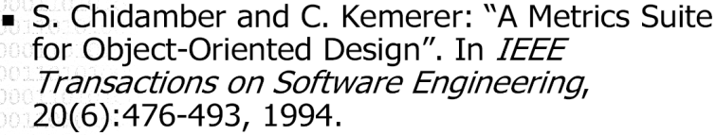
Reference
MOOSE (or CK)
Will be studied in Tutorial 1
soen384-F15-L2: review (1)

Slide 39
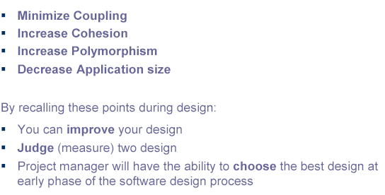
How to interpret the numbers?
Good OOD Rules
soen384-F15-L2: review (1)

Slide 40
Example f interepretation: Degree of Coupling Between Objects
A higher degree of coupling between objects is likely to complicate application maintenance because object interconnections and interactions are more complex.
The higher the degree of object independence (i.e. the more 'uncoupled' objects are from each other) the more likely it is that objects will suitable for reuse within the same applications and within other applications.
Testability is likely to degrade with a more highly coupled system of objects.
soen384-F15-L2: review (1)
Notes:
Object interaction complexity associated with coupling can lead to increased error generation during development

Slide 41
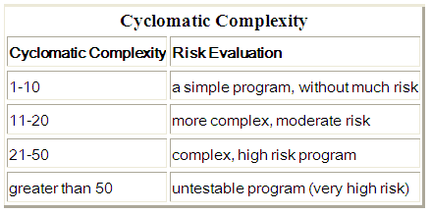
McCabe’s Cyclomatic Complexity: measure of Testability
If G is the control flowgraph of program P and G has e edges and n nodes
v(P) = e – n + 2
v(P) is the number of linearly independent paths in G
here, e = 16, n=13, and v(P) = 5
More simply, if d is the number of decision nodes in G then
v(P) = d + 1
soen384-F15-L2: review (1)

Slide 42
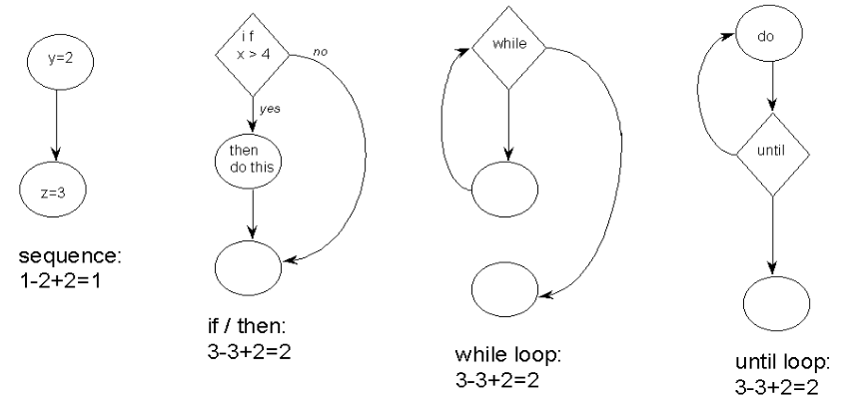
McCabe cyclomatic complexity of the basic constructs
soen384-F15-L2: review (1)

Slide 43
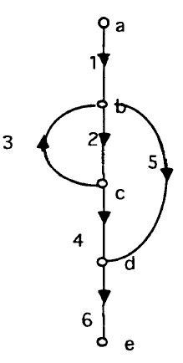
McCabe Cyclomatic Complexity: Measurement Method
G
Solution?
soen384-F15-L2: review (1)

Slide 44
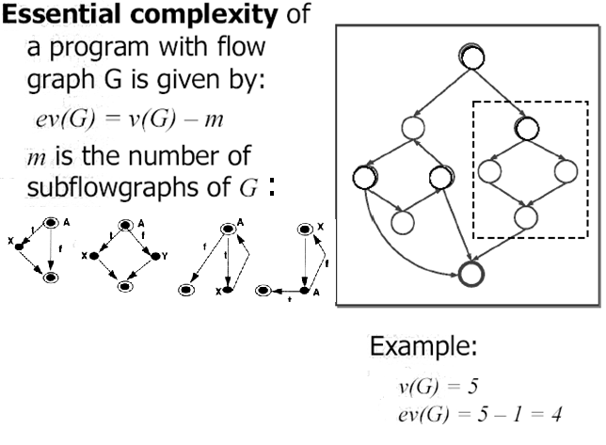
McCabe essential complexity
BEST value: EV(G) = 1
<Completely structured>
soen384-F15-L2: review (1)
Notes:
Measures how much unstructured logic exists in a module
The essential complexity can be computed on a DD-Paths graph in which constructs are collapsed to a single node, until no more structured constructs can be found

Slide 45
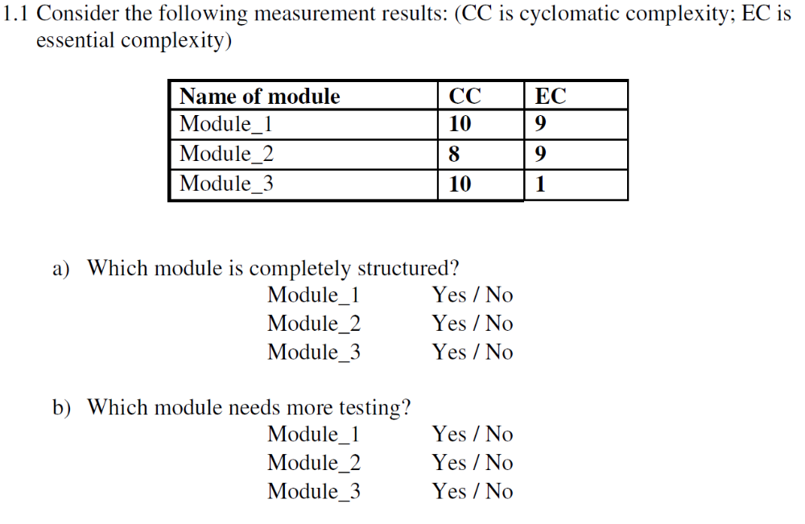
soen384-F15-L2: review (1)

Slide 46
Topic 7: Software Project Quality management
SQA:
  Requirements Reviews and Inspections
Quality modeling:
  ISO 25010 definitions of the quality characteristics functional suitability, performance efficiency, compatibility, usability, reliability, security, maintainability, portability
  IEEE Std.1061-1998 Factor – Criteria –Metrics Software Quality Framework
  Maintainability Quality Model and Measurement with Logiscope
  Examples of Software Quality Engineering requirements
soen384-F15-L2: review (1)

Slide 47
SWEBOK Ch.8 on Quality
“Quality is defined in terms of pertinent attributes of the specific project and any associated product(s), perhaps in both quantitative and qualitative terms. “
  quality characteristics will have been determined in the specification of detailed software requirements
  Thresholds for adherence to quality are set for each indicator
Procedures relating to ongoing SQA throughout the process and for product (deliverable) verification and validation are also specified at this stage
  technical reviews and inspections
soen384-F15-L2: review (1)

Slide 48
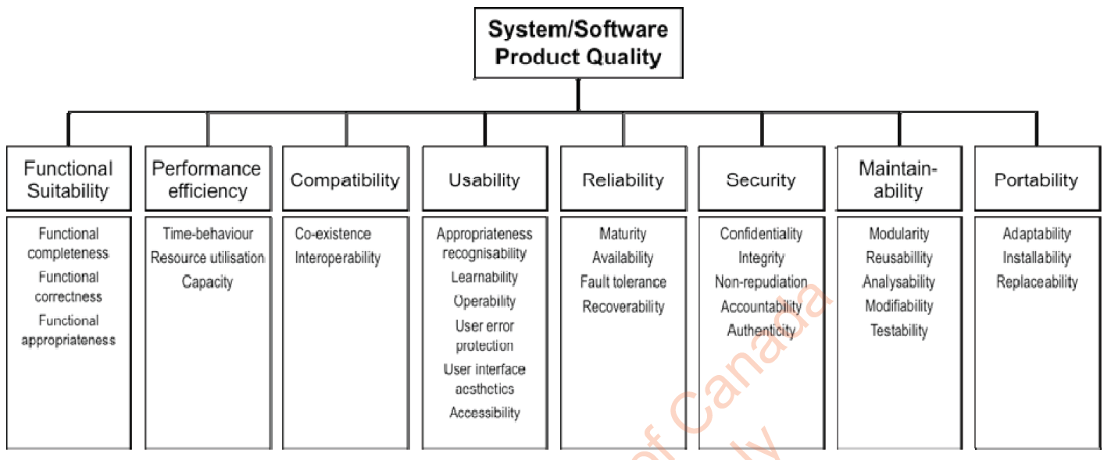
ISO 25010: learn the definitions of the quality characteristics
soen384-F15-L2: review (1)

Slide 49
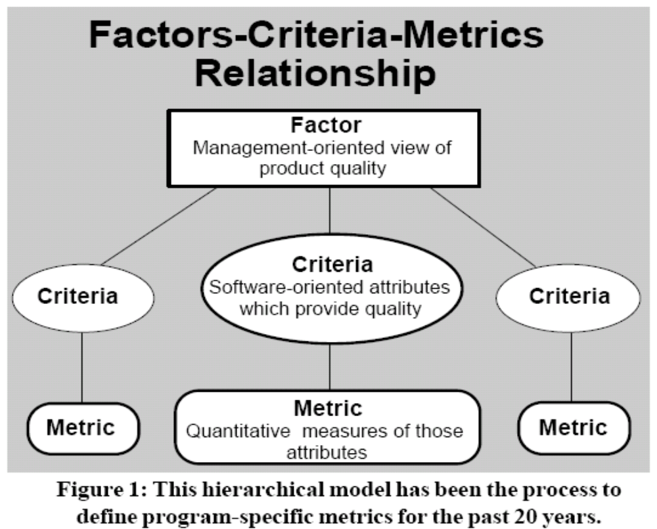
IEEE Std.1061-1998:
Factor – Criteria –Metrics Software Quality Framework
(Criteria)
soen384-F15-L2: review (1)
Notes:
This hierarchical model has been the process to
define program-specific metrics for the past 30 years.
The “factors” at the highest level of the hierarchical model in
Figure 1 define the overall program issues or objectives which will
be addressed by the selected software metrics.
The “criteria” at the next level of the
Factors-Criteria-Metrics model describe
the software product or process characteristics
which are directly linked to the
program issues and objectives. These
characteristics are defined in softwarerelated
terms and represent the critical
software attributes which must be
achieved in the program. The definitions
of software characteristics at this level are
still rather general and are not defined as
specific quantitative values.
The lowest level of the Factors-Criteria-
Metrics model defines the specific
quantitative units to measure the selected
software criteria. These units are directly
linked to the design and physical structure
of the software.

Slide 50
How to Model Quality?
Develop your own model:
  Choose FACTORS: a set of quality attributes important for a given product from an external point of view
  decide on their decomposition into quantifiable CRITERIA from the internal point of view
  agree on specific MEASURES for the criteria and specific relationships between them
Use existing quality standards
soen384-F15-L2: review (1)

Slide 51
Sample OO Quality Model
OO Quality at class level
Factor
Criteria
Criteria
Criteria
Criteria
Criteria
Criteria
Criteria
defects
density
Inheritance
Coupling
Size
Testability
Structuredness
Cohesion
Metrics
Metrics
Metrics
Metrics
Metrics
Metrics
Metrics
#defects
McCabe Cyclomatic Complexity
Essential
Complexity
DIT, NOC
CBO
LCOM
WMC, SLOC
soen384-F15-L2: review (1)
Notes:
Class-Oriented OO Measures (MOOSE, or CK) by Chidamber and Kemerer:
COUPLING:
coupling between object classes
response for a class
INHERITANCE:
depth of the inheritance tree
number of children
COHESION:
lack of cohesion in methods
SIZE:
weighted methods per class

Slide 52
How to Model Quality?
Develop your own model:
  Choose FACTORS: a set of quality attributes important for a given product from an external point of view
  decide on their decomposition into quantifiable CRITERIA from the internal point of view
  agree on specific MEASURES for the criteria and specific relationships between them
Use existing quality standards
soen384-F15-L2: review (1)

Slide 53
ISO Maintainability Quality Model and Measurement with Logiscope
Maintainability
ANALYZABILITY: the capability of the software product to be diagnosed for deficiencies or causes of failures in the software, or for the parts to be modified to be identified
CHANGEABILITY: the capability of the software product to enable a specified modification to be implemented
STABILITY: the capability of the software product to avoid unexpected effects from modifications of the software
TESTABILITY: the capability of the software product to enable modified software to be validated
factor
criteria
Analyzability
Changeability
Stability
Testability
metrics
cl_wmc cl_comf in_bases cu_cdused ... … … …
soen384-F15-L2: review (1)

Slide 54
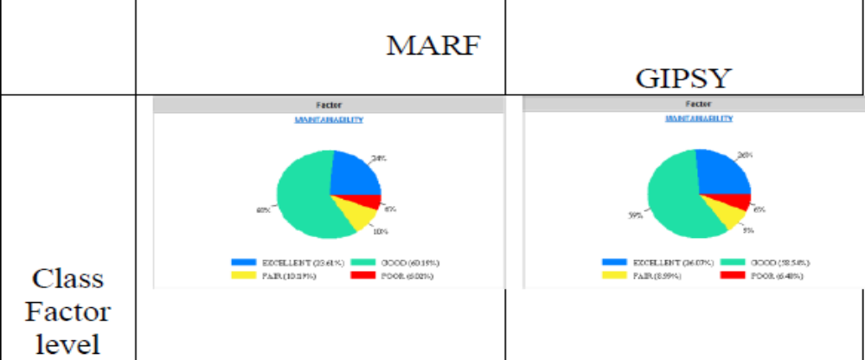
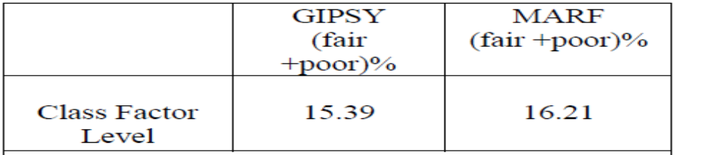
Compare the maintainability of applications at Class Factor level
Maintainability formula for class factor level is:
  MAINTAINABILITY = ANALYZABILITYc + CHANGEABILITYc + STABILITYc + TESTABILITYc [c=class]
Example: compare MARF and GIPSY at Class Factor level
soen384-F15-L2: review (1)

Slide 55
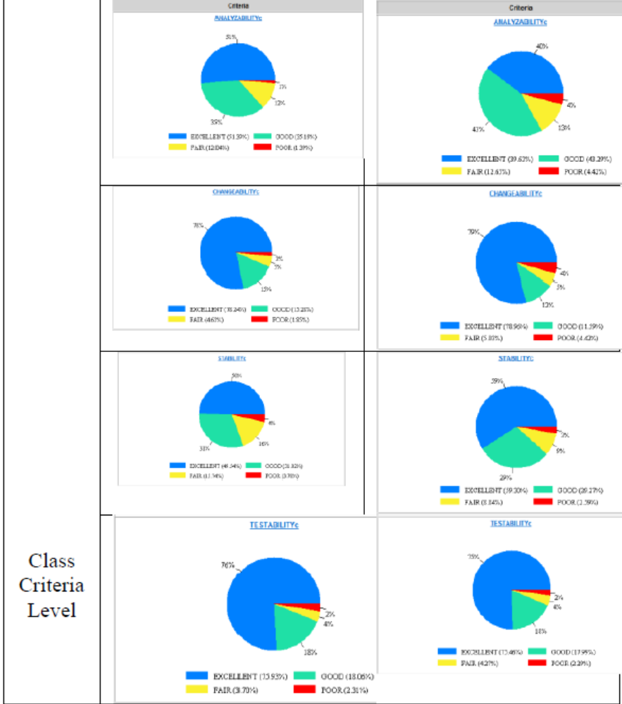
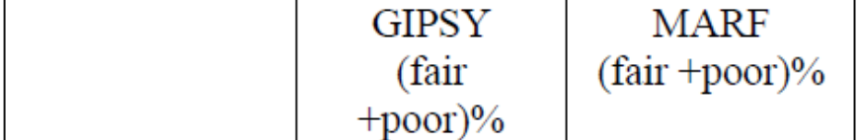
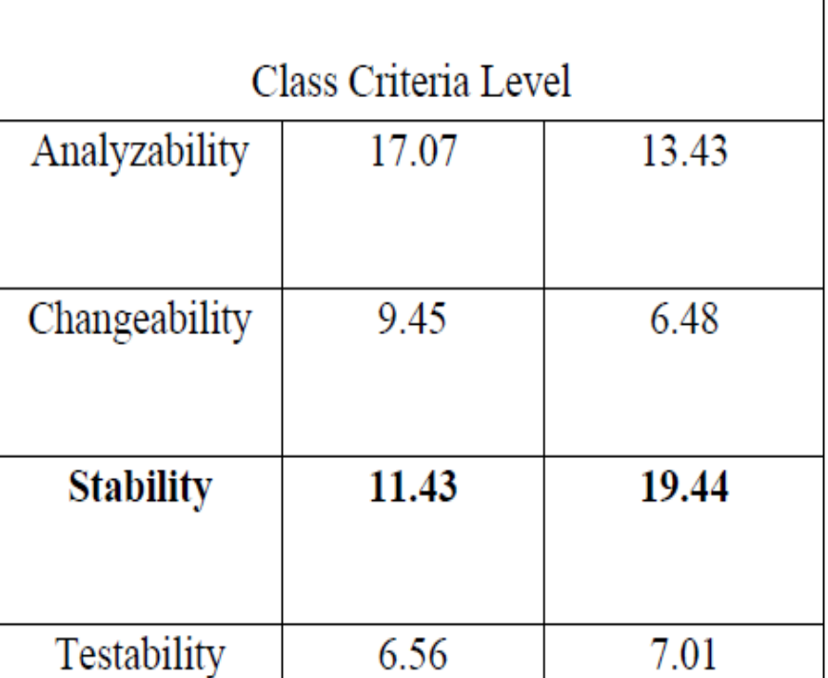
Compare maintainability at Class Criteria Level
soen384-F15-L2: review (1)

Slide 56
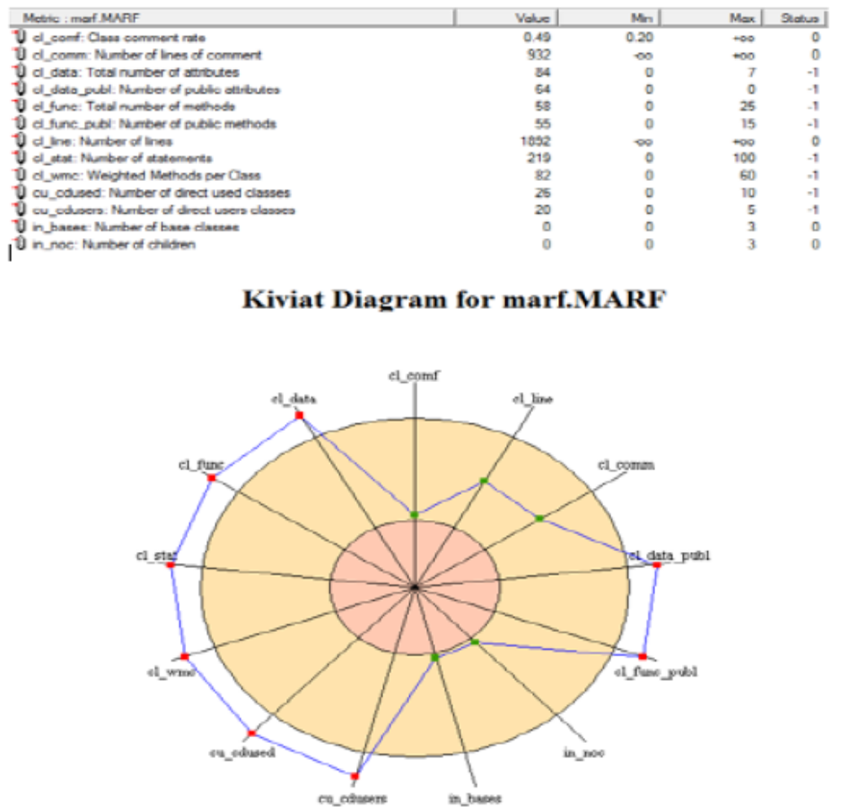
Interpret Class Metric level measurement data
soen384-F15-L2: review (1)

Slide 57
SWEBOK Ch.8 on Quality
“Quality is defined in terms of pertinent attributes of the specific project and any associated product(s), perhaps in both quantitative and qualitative terms. “
  quality characteristics will have been determined in the specification of detailed software requirements
  Thresholds for adherence to quality are set for each indicator
Procedures relating to ongoing SQA throughout the process and for product (deliverable) verification and validation are also specified at this stage
  technical reviews and inspections
soen384-F15-L2: review (1)

Slide 58
Software Quality Control
Quality Control—monitoring specific project results to determine if they comply with relevant quality standards and identifying ways to eliminate causes of unsatisfactory performance. (PMBok)
soen384-F15-L2: review (1)
Notes:
“Set of procedures used by organizations to ensure that a software product will meet its quality goals at the best value to the customer, and to continually improve the organization’s ability to produce software products in the future.”

Slide 59
Reviews and Inspections
A software review is "A process or meeting during which a software product is examined by a project personnel, managers, users, customers, user representatives, or other interested parties for comment or approval".
Inspection is a very formal type of peer review where the reviewers are following a well-defined process to find defects.
soen384-F15-L2: review (1)

Slide 60
Reviews and Inspections
The main objective is to detect defects that escape the originator more than other practitioners
Inspections and reviews are testing of software artifacts without the actual execution of code and is especially suited for:
  Requirements documents
  Design documents
  Plans and Tests Cases
  Have been shown to be up to 75% effective in uncovering design flaws (which constitute 50-65% of all errors in software)
soen384-F15-L2: review (1)
Notes:
A software review is "A process or meeting during which a software product is examined by a project personnel, managers, users, customers, user representatives, or other interested parties for comment or approval".
Inspection is a very formal type of peer review where the reviewers are following a well-defined process to find defects.

Slide 61
Reviews and Inspections
Objectives
  To uncover errors in function, logic, or implementation for any representation of the software
  To verify that the software under review meets its requirements
  To ensure that the software has been represented according to predefined standards
  To achieve software that is developed in a uniform manner
  To make projects more manageable
Serves as a training ground for junior software engineers to observe different approaches to software analysis, design, and construction
Promotes backup and continuity because a number of people become familiar with other parts of the software
soen384-F15-L2: review (1)

Slide 62
The Reviews and Inspections Results
The review leader produces a list of review issues that
    Identifies problem areas within the product
    Serves as an action item checklist to guide the producer in making corrections
The review leader includes the list in a reviews / inspections summary report
    This one to two-page report describes what was reviewed, who reviewed it, and what were the findings and conclusions
The review leader follows up on the findings to ensure that the producer makes the requested corrections
soen384-F15-L2: review (1)

Slide 63
Reviews/Inspections Benefits
Quality : Find and correct defects
Productivity : Reduce time-to-market
Efficiency : Correct defects at their point of origin
Cost :
  up to 1,000 times cheaper to correct an error during analysis than during test
  up to 40,000 times if the defect is correct before deployment!
soen384-F15-L2: review (1)

Slide 64
Next class
Review of the remaining topics:
  Topic 4: Simple measurement data analysis techniques
  Topic 5: Goal-Based Measurement (see also the this week’s tutorial notes)
  Topic 6: Software Measurement Program to be used in soen390/490
  Topic 8: Simple Effort Estimation techniques
  Topic 9: Management Key Area (KA) 1: Initiation and scope definition.
soen384-F15-L2: review (1)

Slide 65
Topic 3: Representational Theory of Measurement
Scale Types: Nominal, Ordinal, Interval, Ratio, Absolute.
  Give examples of each and understand the differences between the scale types.
Measurement scales and statistics relevant to each scale type
Meaningfulness
soen384-F15-L2: review (1)

Slide 66
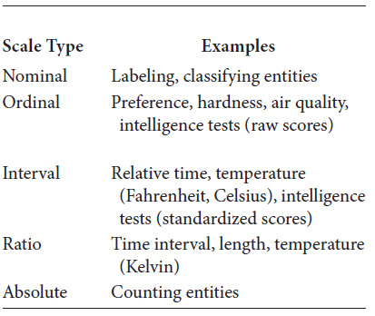
Examples. Understand the differences between the scale types
soen384-F15-L2: review (1)

Slide 67
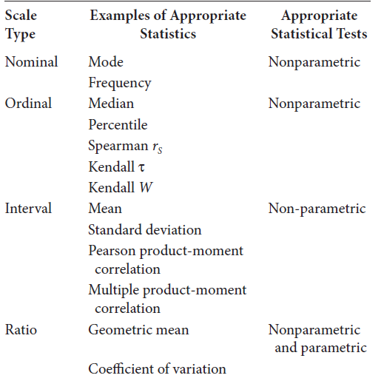
Summary of measurement scales and statistics relevant to each
soen384-F15-L2: review (1)

Slide 68
More exercises
See lecture 9
soen384-F15-L2: review (1)

